Slide 1

Property Inspection

Slide 2
Introduction
An insurance company provided a wide range of insurance products and services designed to meet their customer needs for over 100 years.
Many insured properties receive a home inspection. These inspections review the condition of key attributes of the property, including things like the foundation, roof, windows and sliding. The results of an inspection help the insurance company to insure.

Slide 3
Import Packages
import pandas as pd
import matplotlib as mb
import matplotlib.pyplot as plt
import seaborn as sb
import numpy as np
from scipy import stats
from sklearn.model_selection import train_test_split
from sklearn.model_selection import cross_val_score
from sklearn.metrics import make_scorer
from sklearn.ensemble import RandomForestRegressor
import xgboost as xgb
from sklearn.preprocessing import LabelEncoder
%matplotlib inline

Slide 4
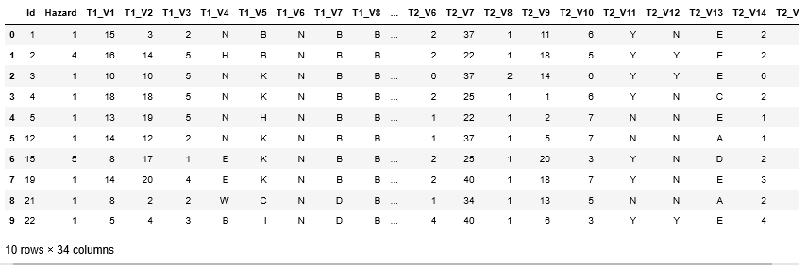

Data Loading
Load the property inspection dataset. The dataset have 33 properties which are both numerical and categorical data, column names are not clearly explaining the property. Considering this has unlabeled data. Applying feature selection is difficult on unlabeled data.

Slide 5
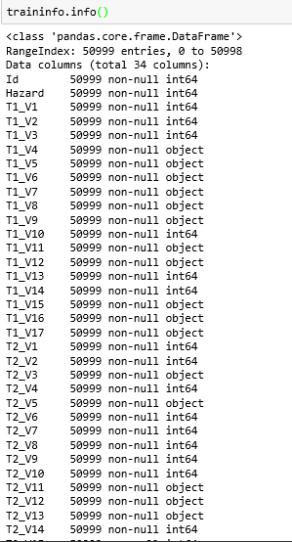
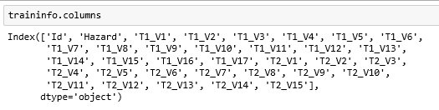

Data Manipulation and Feature Selection
Below are the column names of this dataset, which exclude Id column, as it just represents the row count.
Info method briefs the records count, data type. It also gives us the each data type count at the end of the output.

Slide 6
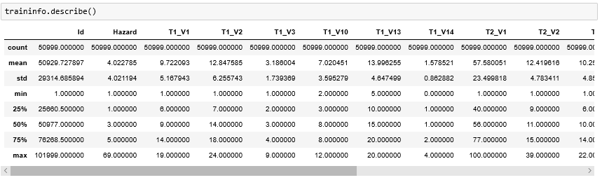
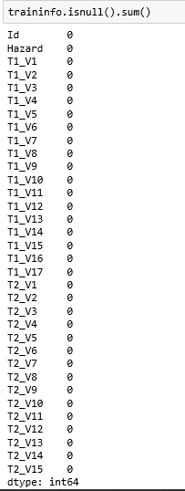
describe method gives the std, min, mean, 25%, 50%, 75% and max values for all numerical data.
Checking for null values in the dataset and below code shows there are no null values.

Slide 7

Drop the Id column, it is a rows count which is not required in this analysis.
Plot the heatmap to check the correlation between the properties.
With reference to below heat map, following are the observations noticed. 1) T2_v6 and T2_V14 are high positively correlated to each other. 2) T2_V15 and T1_V13 are slightly negatively correlated. 3) T2_V4 and T2_V14 are strongly negatively correlated.

Slide 8
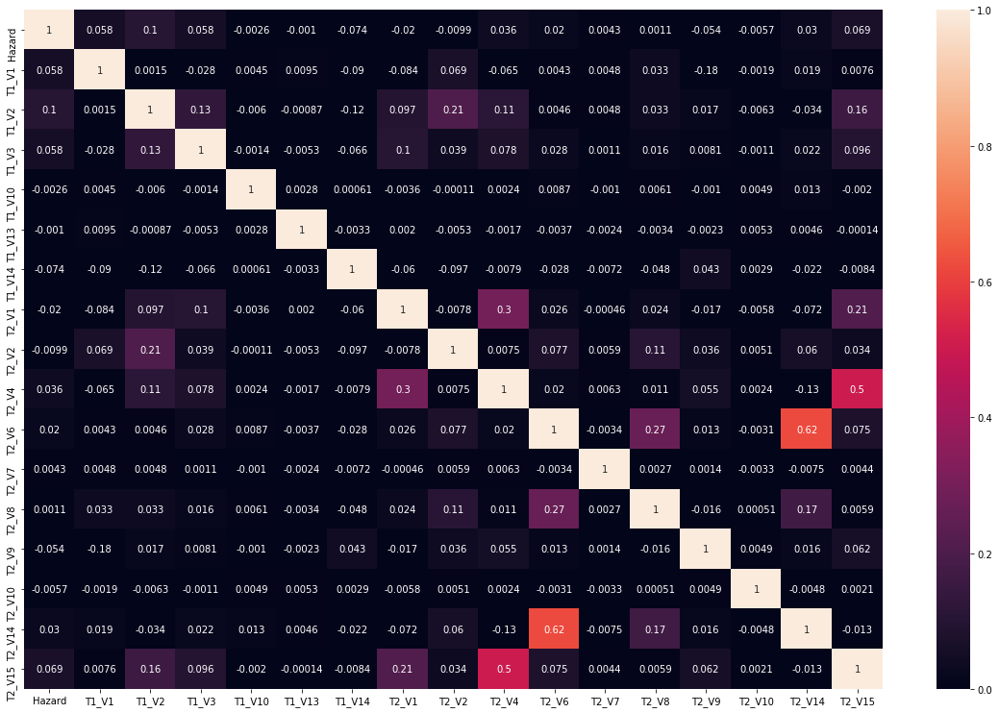

Slide 9

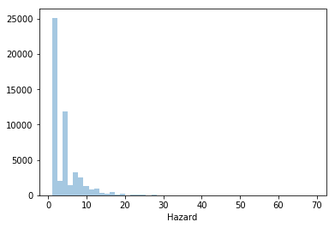
Target variable "Hazard" values are highly spread in the range from 1 to 4. Around 25000 rows are having Hazard value "1" and the numbers are quiet big. There is higher chance the prediction will not be proper, because the data is right skewed. One option is to normalize the values of "Hazard".

Slide 10
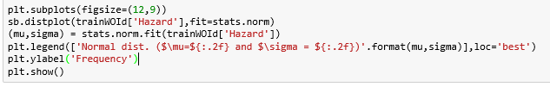
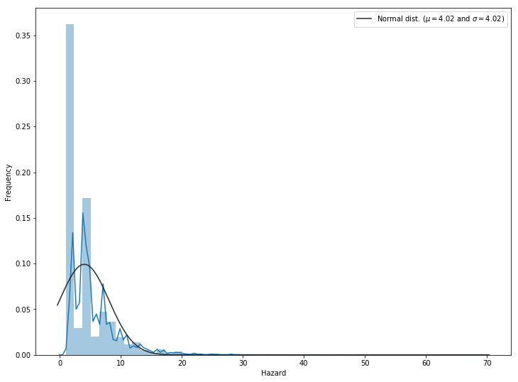

Slide 11
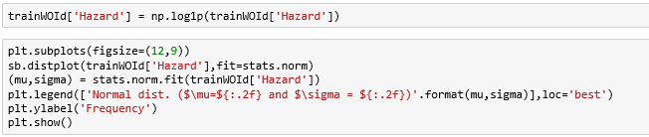
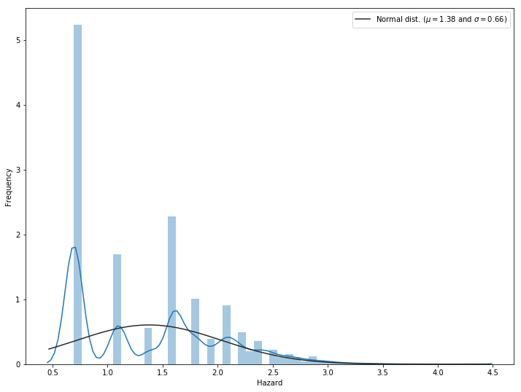
Apply normalization on "Hazard" values. Now the values are in the range 0.5 to 4.5.

Slide 12
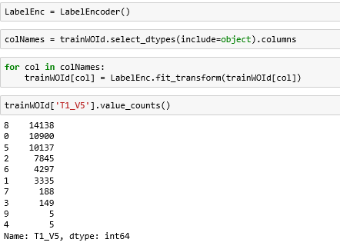
There are categorical variables which has to convert into numerical to apply model and predict. One of the option used is LabelEncoder.
Check T1_V5 which is a categorical variable which converts into numerical after label encoding.

Slide 13

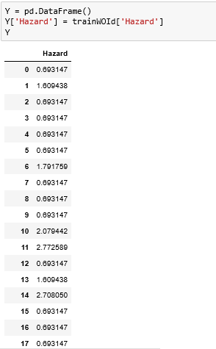
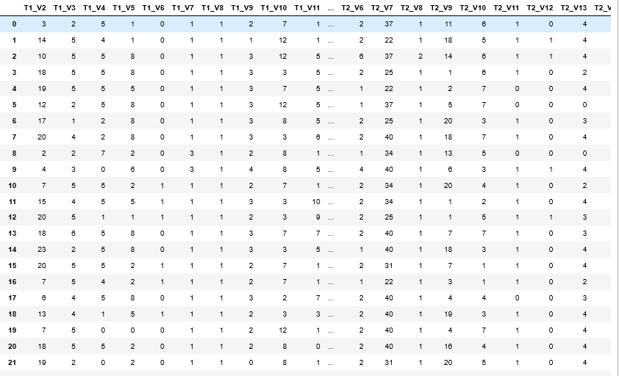
Create two dataframes (X, Y) with dependent variables into one dataframe and target variable into another dataframe to perform model evaluations.

Slide 14
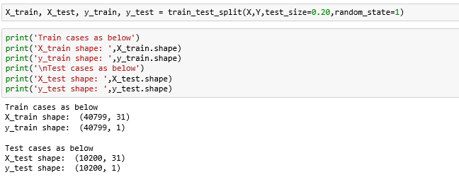
Model Evaluation
Split the dataframe into train and test using train_test_split method with test size of 20%.

Slide 15
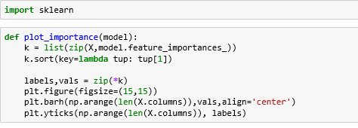
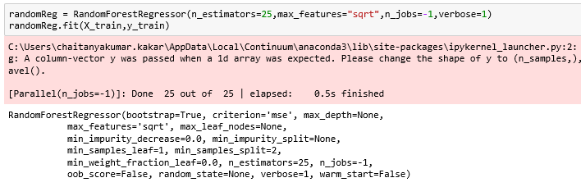
Function to plot the importance of all the dependent variables with Target variables after fitting the data into the models.
Using Random Forest Regressor with 25 estimators and plot the importance of all the dependent variables and identify the top 5 variables

Slide 16
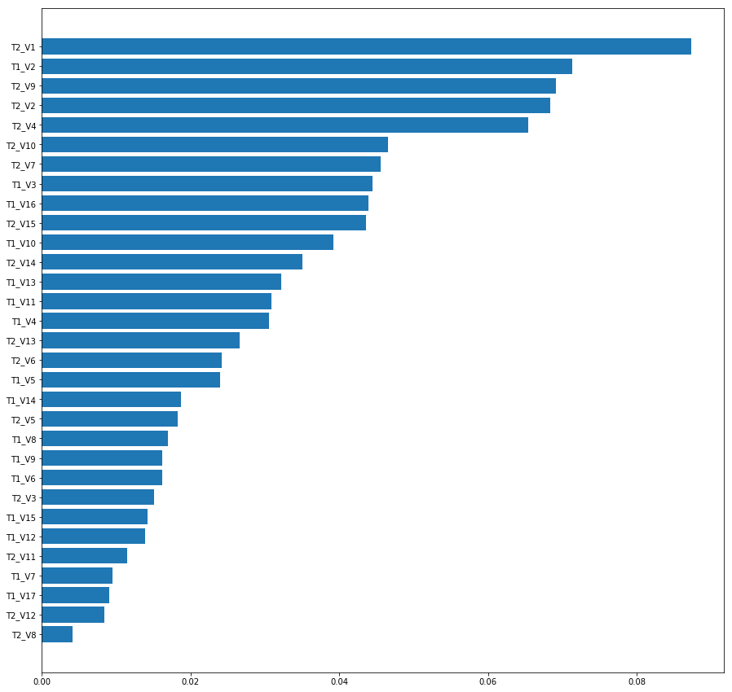

T2_V1, T1_V2, T2_V9, T2_V2 and T2_V4 are the top 5 Variables which gives more value to the model.

Slide 17
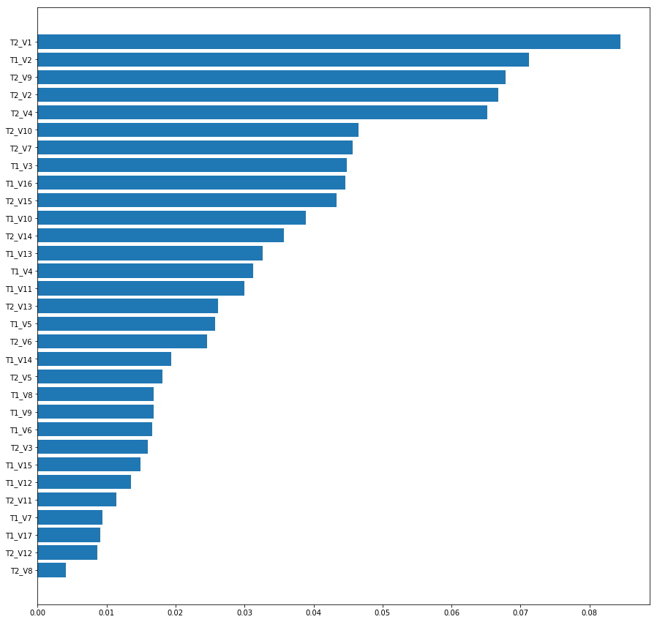
. Increase the estimators to 500 and max_features as "log2" and plot the dependent variables importance.
Again T2_V1, T1_V2, T2_V9, T2_V2 and T2_V4 are the top 5 dependent variables.

Slide 18
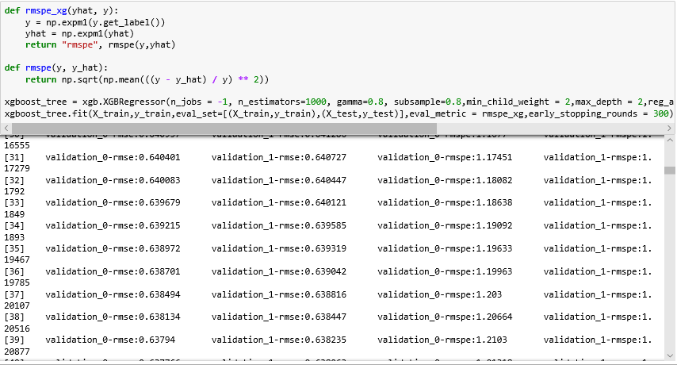
Top 5 are same in both random forest models. Now try to apply Xgboost and plot the importance again.

Slide 19
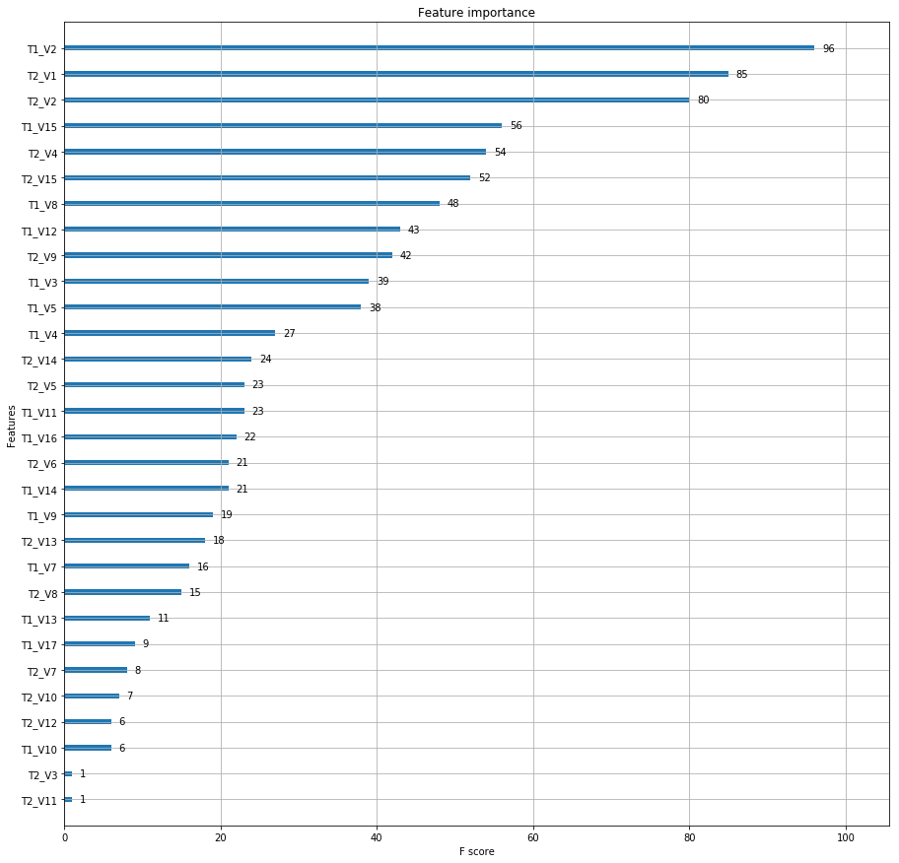
Xgboost gave T1_V2 is the most important dependent variable, But random forest gave T2_V1 is the important variable and Xgboost gave similar list like random forest except T1_V15.

Slide 20
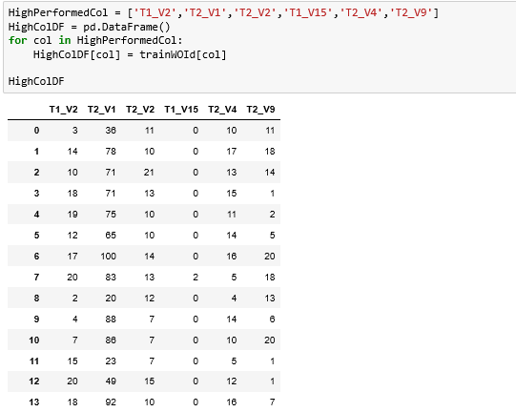
Now check the performance of top variables by applying Xgboost and Random forest.

Slide 21
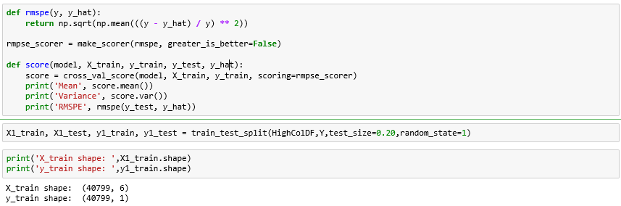

Slide 22
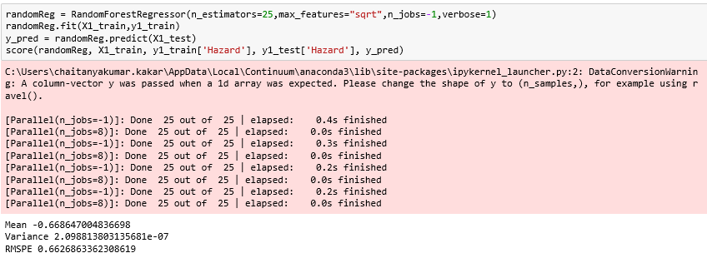
Random forest gives good result. Lets increase the estimators to 1000 and check the RMSPE.

Slide 23
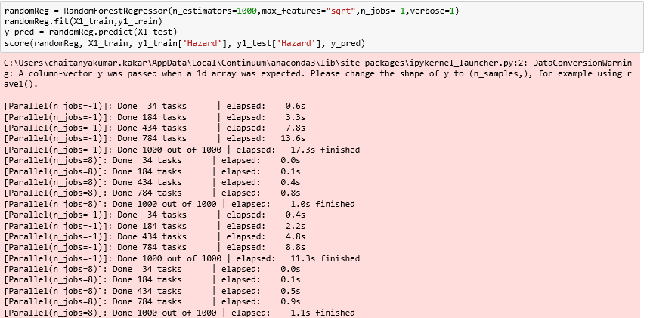

Still there is not much difference in RMSPE value. Lets check Xgboost results.

Slide 24
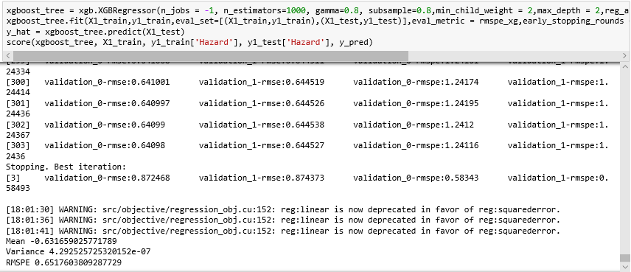
Xgboost results also good, but RMSPE value is almost same like Random forest. Let's apply Gradient Boost Regressor and check the RMSPE value

Slide 25
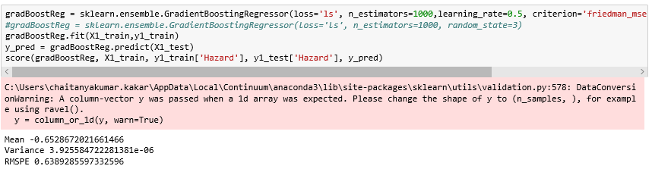
Well, Gradient Boost Regressor also performs good.

